Slide 1
"Sales Analytics: Exploring Online Retail Patterns for Business Growth"
Presented by:
Deepali kumari (AP22122040007)
Shrishti Shiva(AP22122040009)

Slide 2
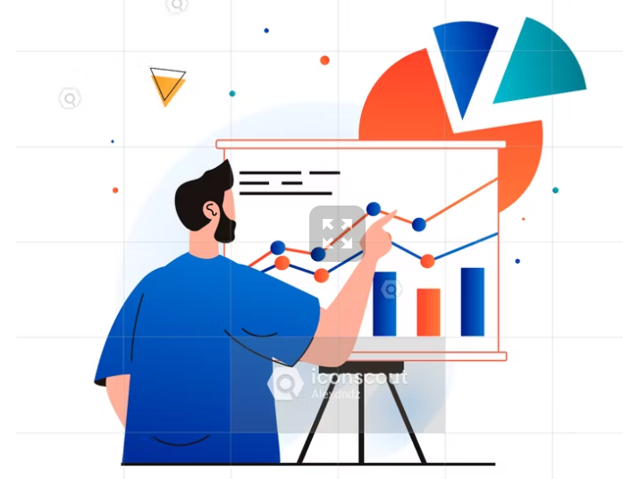
Agenda
Introduction
Sales analysis on online retail dataset
Applied sales analysis techniques
Implementation
Conclusion

Slide 3
Introduction
Sales analysis: Sales analysis refers to the examination and interpretation of sales data to gain insights into the performance and trends of a business.
In the context of online retail, sales analysis involves analyzing the data generated from online transactions, customer interactions, and other relevant sources.
Online retail dataset : An online retail dataset is a collection of structured data that captures various aspects of online retail operations, including customer information, product details, sales transactions, and more.

Slide 4
Sales analysis on the online retail dataset
It involves applying various analytical techniques to gain insights into sales performance, customer behavior, and market trends.
By analyzing sales data, businesses can identify top-selling products, popular product categories, and customer preferences.

Slide 5
Applied sales analysis techniques
Customer analysis
Product analysis
Sales analysis
Market basket analysis
Time series forecasting

Slide 6
Implementation
Importing libraries:
Pandas
Numpy
Seaborn,etc
Importing dataset
Data preprocessing: null, dropping, droping duplicates

Slide 7
Implementation contd.
Customer analysis:In this we are converting quantity and unitprice value to numeric value
Calculating total_revenue= quantity * unit price (each transaction)
Calculating total_revenue of column (all transaction) and print it.
After that we are making group of customerid ,and then select totalrevenue then calculate sum of total_revenue for each unique customer.
And then find the top 10 customer based on their total revenue ,then print customers with their revenue.
Then calculating purchasing pattern .

Slide 8
Implementation contd.
Product analysis: grouping the product based on their description.
Calculating the total quantity sold for each product.
Finding the top-selling products and print it.
After that identifying top selling product based on the group description and quantity column and print top selling product.
After that analyze product performance by category by group country and total_revenue column and print it.

Slide 9
Implementation contd.
Sales analysis:grouping invoicemonth and total_revenue column and using the sum() to calculate the total revenue for each unique invoice of the month.
Analyzing sales trends over time and print it.
then plotting it.
After that calculating
Quantity price ratio=quantity/unit price
then applying discount based on quantity price ratio. If quantity price ratio > 60 % then apply discount of 10%.
Then calculating how discount affecting the sale and print it.

Slide 10
Implementation contd.
Market basket analysis: first creating the basket matix of invoice number and description.
It calculates the sum of the 'Quantity' column for each unique combination of 'InvoiceNo' and 'Description’.
Performing Apriori algorithm:
Minimum Support 0.05 and print the function.
The frequent itemsets with a support value equal to or greater than the minimum support are retained and print it.

Slide 11
Implementation contd.
Time series: groups the data in the DataFrame by 'InvoiceDate' and calculates the sum of the 'TotalRevenue' column for each unique date.
Spiliting dataset into training set and testing set.
After that creates an instance of the SARIMAX model, specifying the order of the autoregressive (AR), integrated (I), and moving average (MA) components, as well as the seasonal order.
Calculate mean square error and print result.

Slide 12
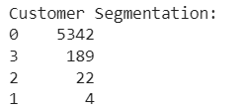
CUSTOMER SEGMENTATION
Here, we performs customer segmentation using K-means clustering based on total revenue, number of unique invoices, & quantity of items purchased.
It assigns customers to different segments & provides insights into different customer groups with distinct characteristics & behaviors.
Enables businesses to understand customers, identify growth opportunities, and make data-driven decisions for business growth.
Here, one cluster represents high-value customers, another represents price-sensitive customers, and so on. The interpretation of each cluster will depend on the specific dataset.

Slide 13
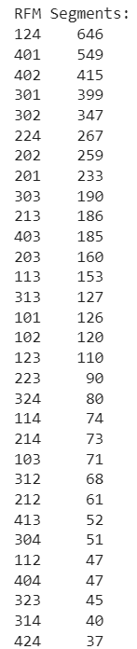
RFM (Recency, Frequency, Monetary) analysis
RFM is a customer segmentation technique that ranks customers based on their recency of purchase, frequency of purchase, & monetary value.
Helps businesses identify segments of customers based on their purchasing behavior, which can indirectly provide insights into product preferences and demand.
Once customers are segmented based on their RFM scores, businesses can analyze the purchase history of each segment to identify patterns and trends in product preferences.

Slide 14
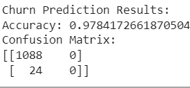
Churn prediction
Churn prediction in data mining refers to the process of predicting or identifying customers or users who are likely to stop using a product or service.
Helps businesses predict & prevent customers from leaving, allowing them to take proactive steps like personalized marketing & improved customer satisfaction to keep customers loyal and ensure business growth.
Logistic regression is used in churn prediction. It predicts the probability of a binary outcome, such as whether a customer will churn or not.
The churn prediction model achieved a high accuracy of 97.8%, accurately classifying most customers. The confusion matrix shows that the model accurately predicted 1088 customers who are likely to stay (non-churned), but it wrongly classified 24 who are likely to churn as non-churned.

Slide 15
WORKING OF CHURN PREDICTION
Churn data is prepared by aggregating customer data to calculate total revenue, number of unique invoices, and total quantity for each customer.
The 'Churn' column is created by determining if the last invoice date is older than 365 days.
The data is split into training and testing sets.
A logistic regression model is trained on the training data.
Churn prediction is performed on the test set.
Model accuracy and the confusion matrix are displayed.

Slide 16
LINEAR REGRESSION
Linear regression is performed for revenue prediction.
The 'TotalRevenue' column is used as the independent variable, and the 'Quantity' column is used as the dependent variable.
Revenue is predicted using the trained model and added as the 'PredictedRevenue' column in the DataFrame.
Enables businesses to make accurate revenue projections and inform sales strategies.
Linear regression is used for understanding the relationship between revenue and total revenue, aiding in informed decision-making for sales and market growth.

Slide 17
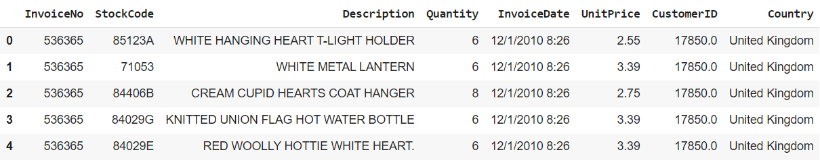
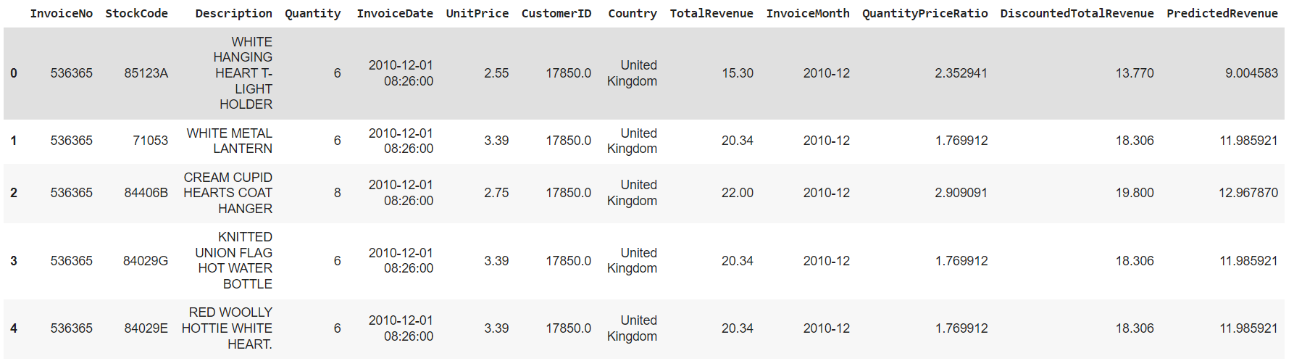

Slide 18
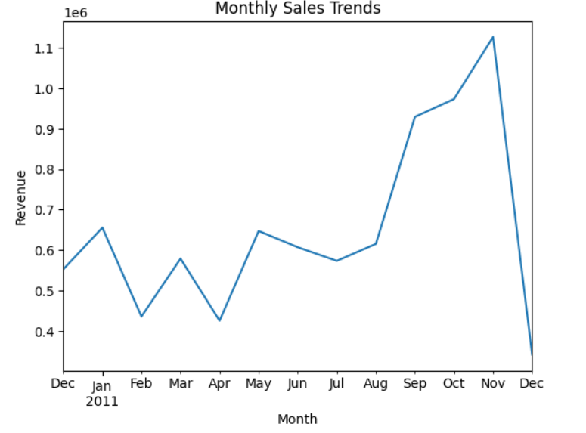
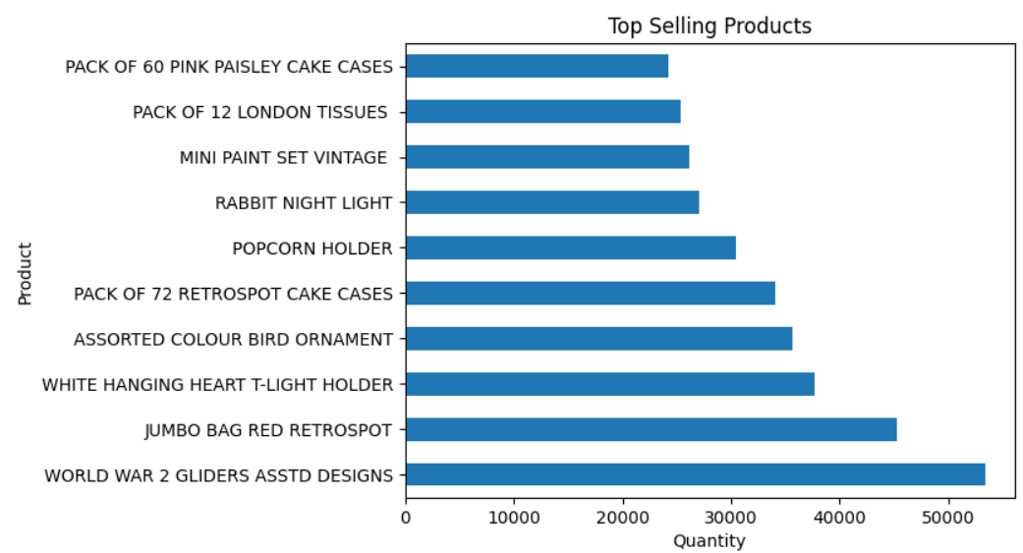
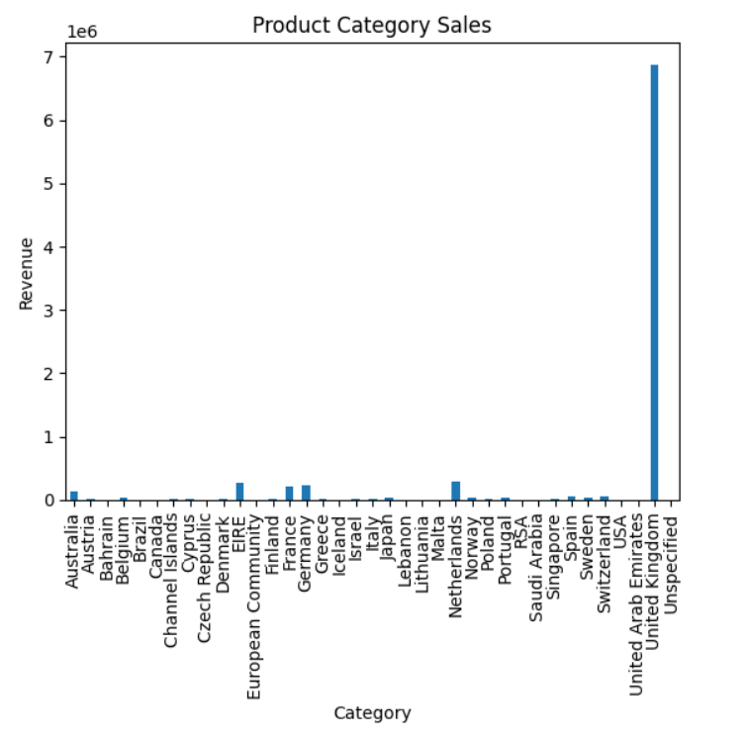
Monthly sales trends are visualized using a line chart. Top-selling products are visualized using a horizontal bar chart. Product category sales are visualized using a bar chart.

Slide 19

CONCLUSION
The analyses and predictions help identify top customers, top-selling products, sales trends, market basket patterns, forecast future sales, segment customers, predict churn, and visualize key metrics.
By understanding all these points businesses can make data-driven decisions to improve sales, customer satisfaction, and overall market growth.

Slide 20

FUTURE SCOPE
Further exploration and implementation of advanced analytics techniques can be used to gain deeper insights and drive business growth.
The project's methodology and analytical approach can be applied to other datasets in various industries, providing valuable insights and driving growth.

Slide 21

THANK YOU

